Slide 1
CEDO PROJECT
File created on: 8/26/2023 9:41:45 PM

Slide 2
Company Background
(RMG) is a reputable mortgage lender with a strong presence in New York, Massachusetts, North Carolina, Texas, and Florida. As a subsidiary of North Beach Bank, RMG benefits from over 250 years of experience in the financial industry. RMG offers a full range of mortgage services, including purchase, refinance, and construction lending.

Slide 3
Project Overview
RMG currently receives mortgage applications from customers through online submissions, email/fax, and Zillow. The applications arrive in various formats, creating inefficiencies and potential data errors. The need for an ETL/ELT solution arises to consolidate the applications, validate their data, and streamline the loan approval process.

Slide 4
SCOPE OF THE PROJECT
The scope of this project includes the design, development and implementation of an ETL/ELT solution for consolidating and validating loan applications from three sources: online applications from RMG’s website, email/fax applications manually entered into a spreadsheet and real-time applications from Zillow. The solution will also include data cleaning, transformation tasks and reporting capabilities through Tableau. Use of Predictive modeling to determine house prices.

Slide 5
LOANING PROCESS AT RMG COMPANY
Zillow website
ETL PROCESS & LOAN VERIFICATION
MAIN SERVER
LOAN ISSUANCE
RMG Online website
Fax/ Email

Slide 6
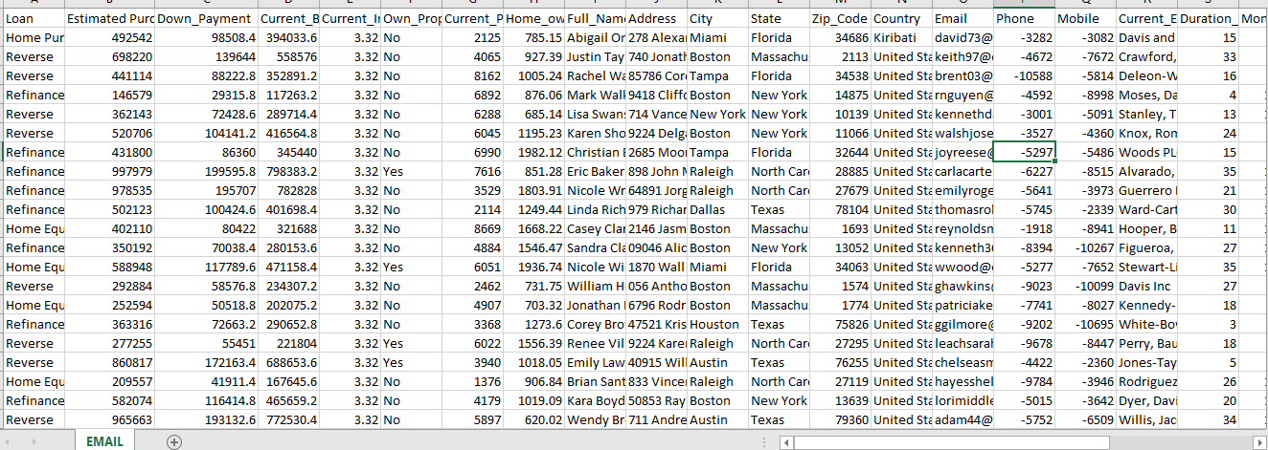
COMING UP WITH THE DATASETS
Used excel to retrieve and merge all the applications from the various sources i.e from Excel, Zillow and Online Applications
EMAIL TABLE

Slide 7
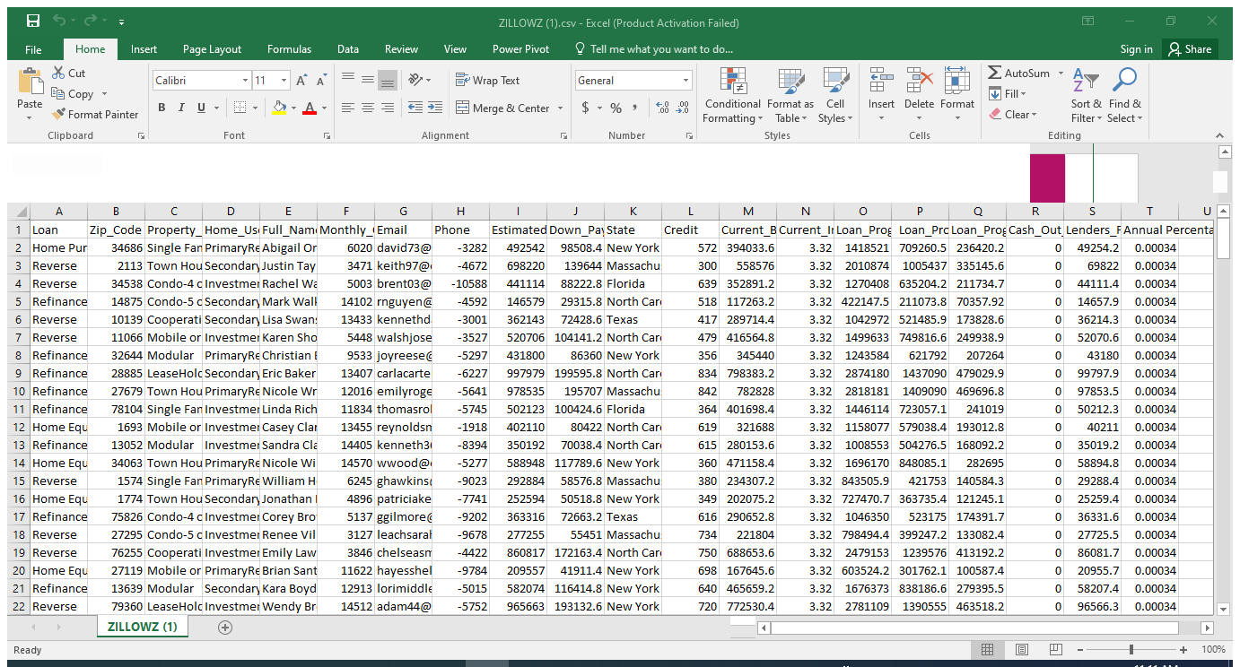
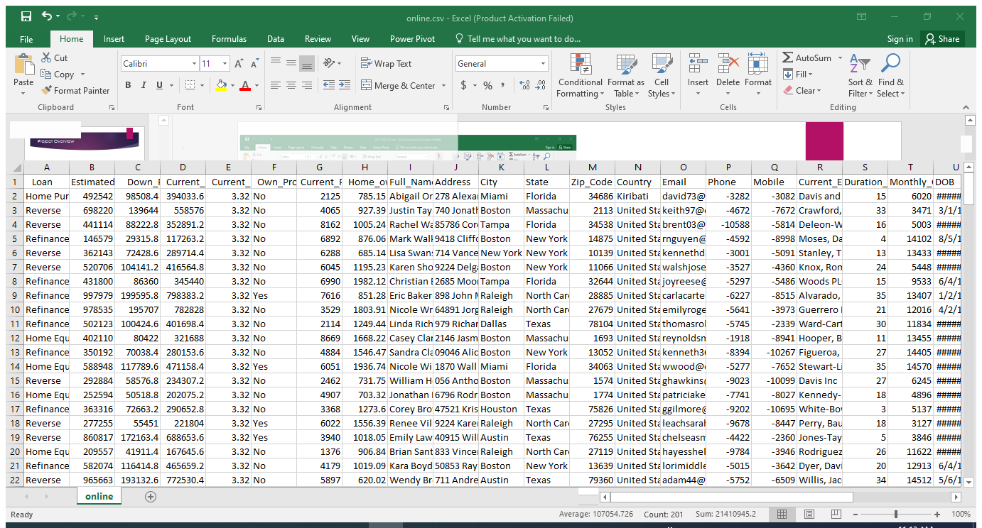
ZILLOW TABLE
ONLINE TABLE

Slide 8
SQL
Performed calculations and statistical analysis .
Performed general analysis to each and every table thereafter tabled the findings
Retrieved specific pieces of data from the databases.
Used SQL to perform the filtering process to the datasets

Slide 9
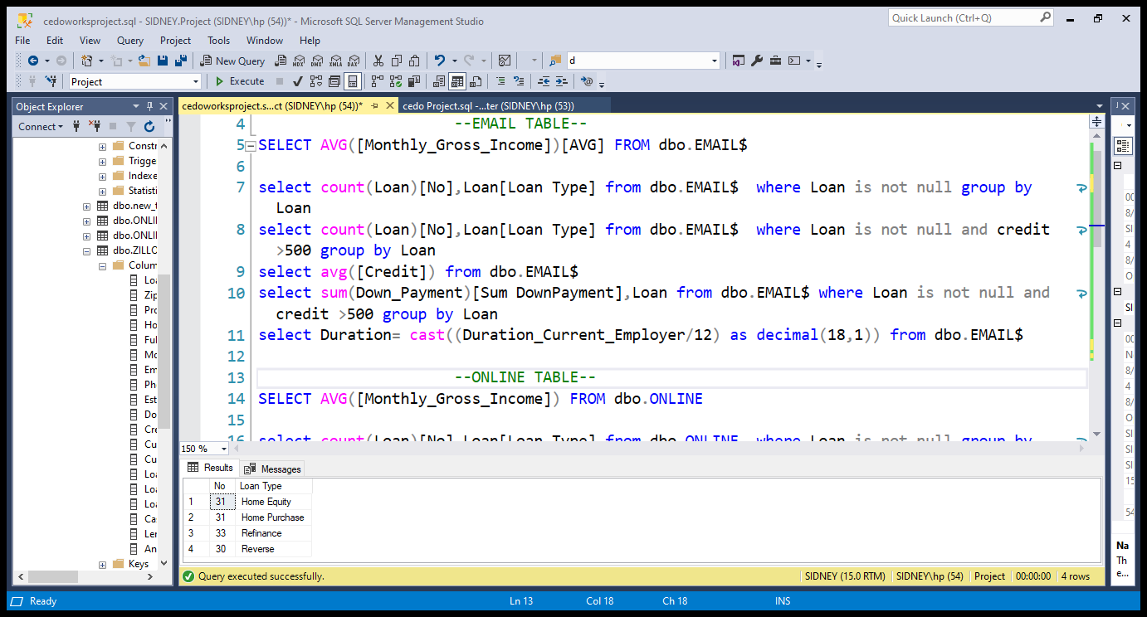

Slide 10
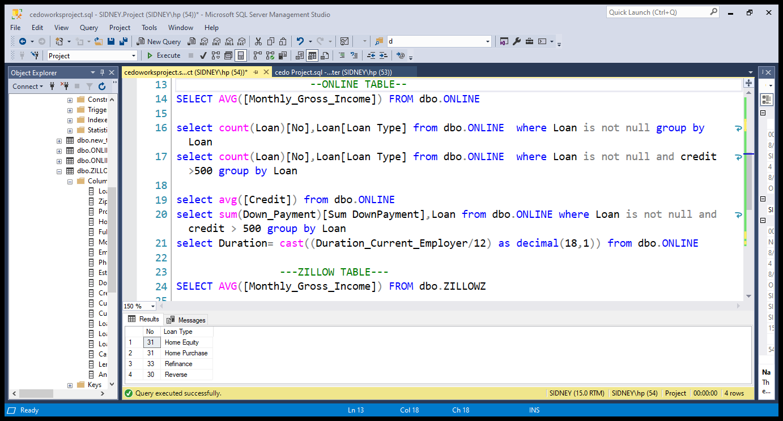
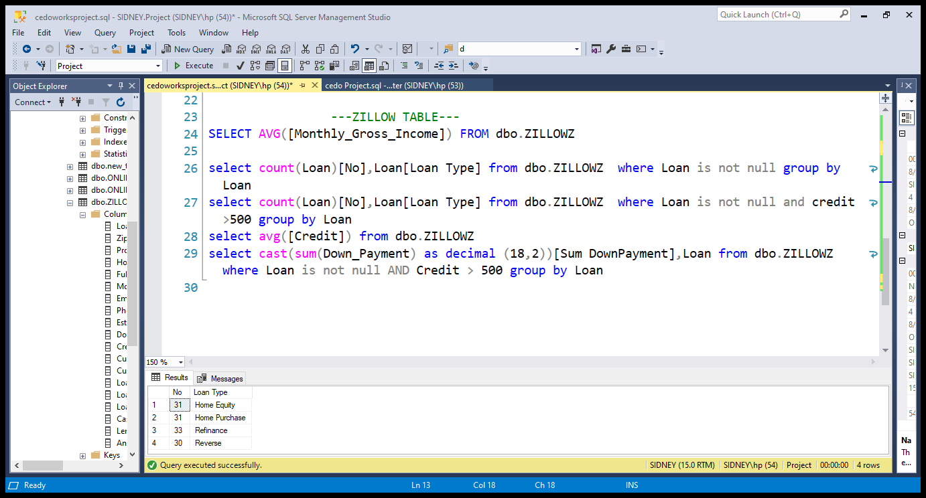

Slide 11
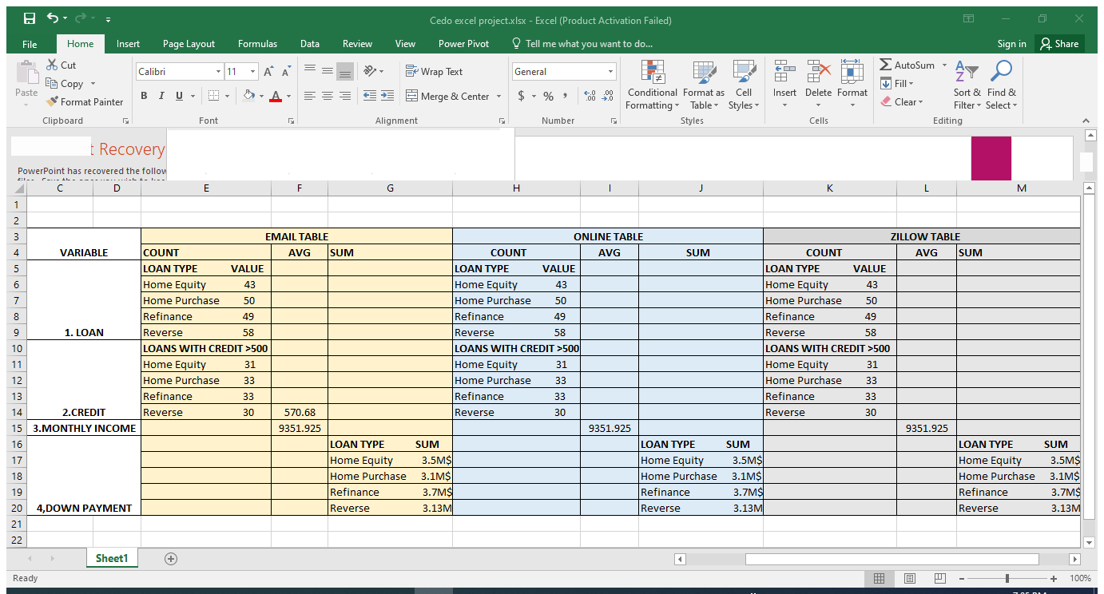
FINAL RESULT FROM SQL

Slide 12
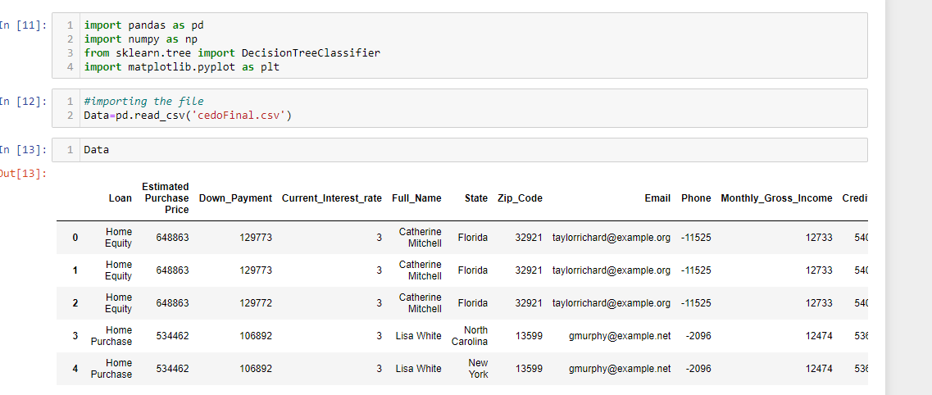
ONTO PYTHON AND MACHINE LEARNING
Used Machine Learning to predict the house prices
Came up with a graph to determine the house prices with respect to the independent variable.

Slide 13
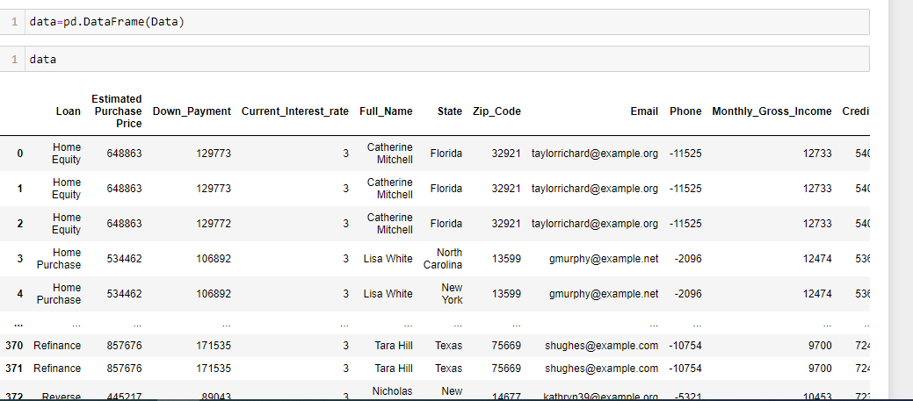

Slide 14
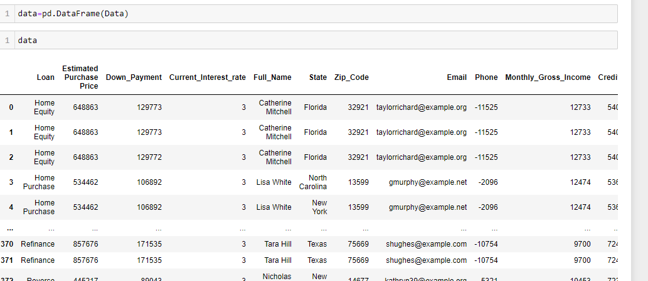
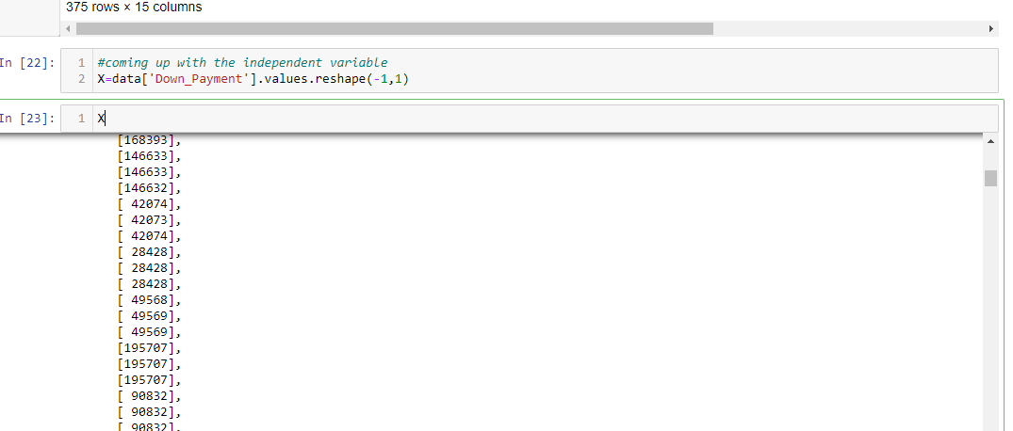

Slide 15
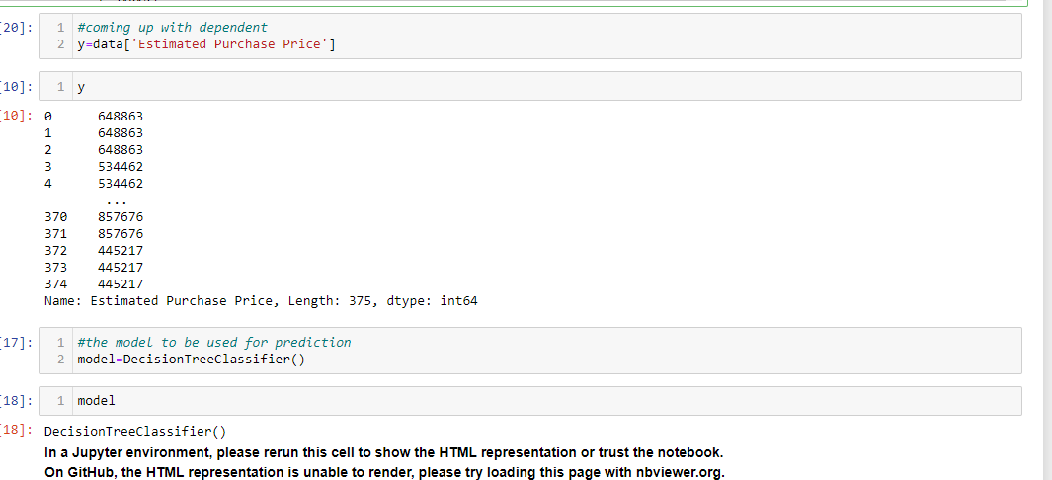

Slide 16
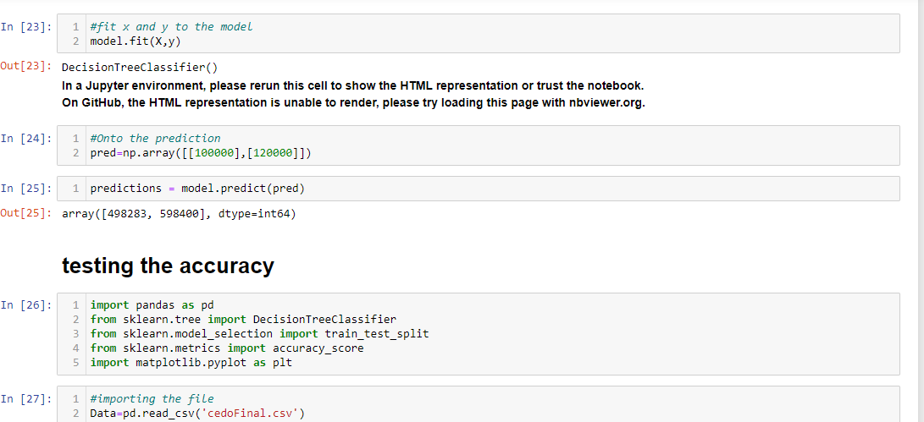

Slide 17
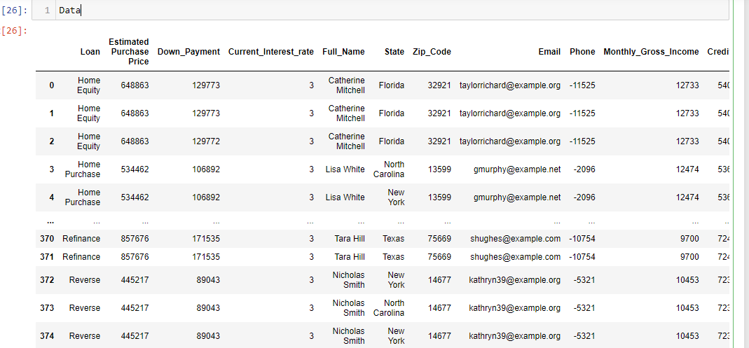
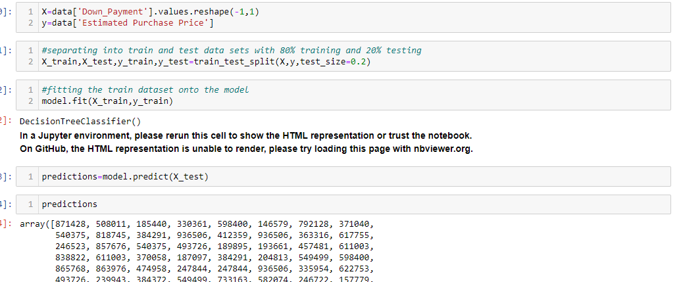

Slide 18
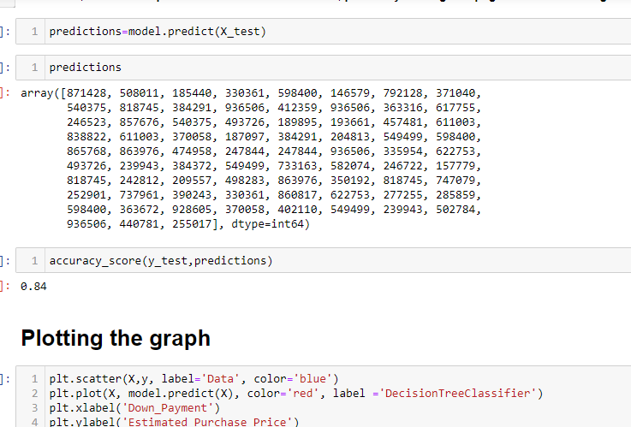
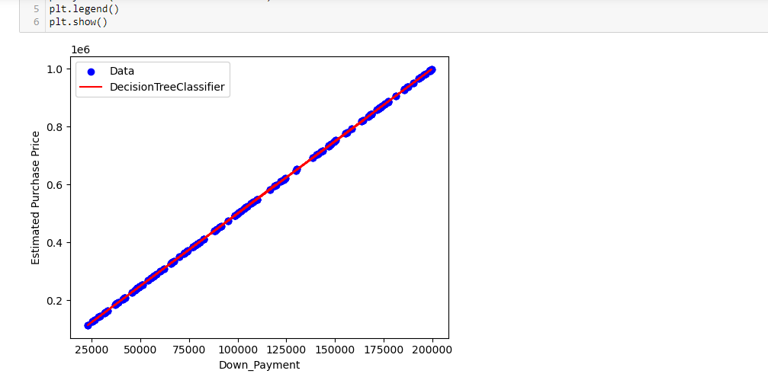

Slide 19
ALTERYX
Merged the 3 datasets.
Filtered to get the applications with 500 and above in credit score
Used tiling to assign values to groups of datasets based on ranges in the data.

Slide 20
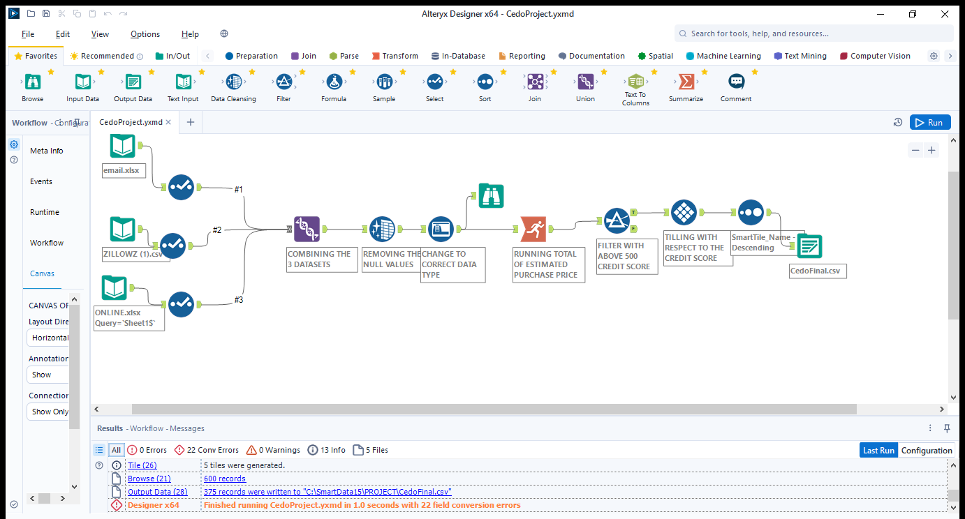

Slide 21
TABLEAU
Tableau was used to visualize data and to derive insights on how to drive growth at RMG Company.
Came up with recommendations to spur growth at the Company
Produced reports and charts that communicate the general performance of our business.
Translated abstract data into easily digestible and highly visual dashboard applications.
Defined the KPIs
Collected and refined the data

Slide 22
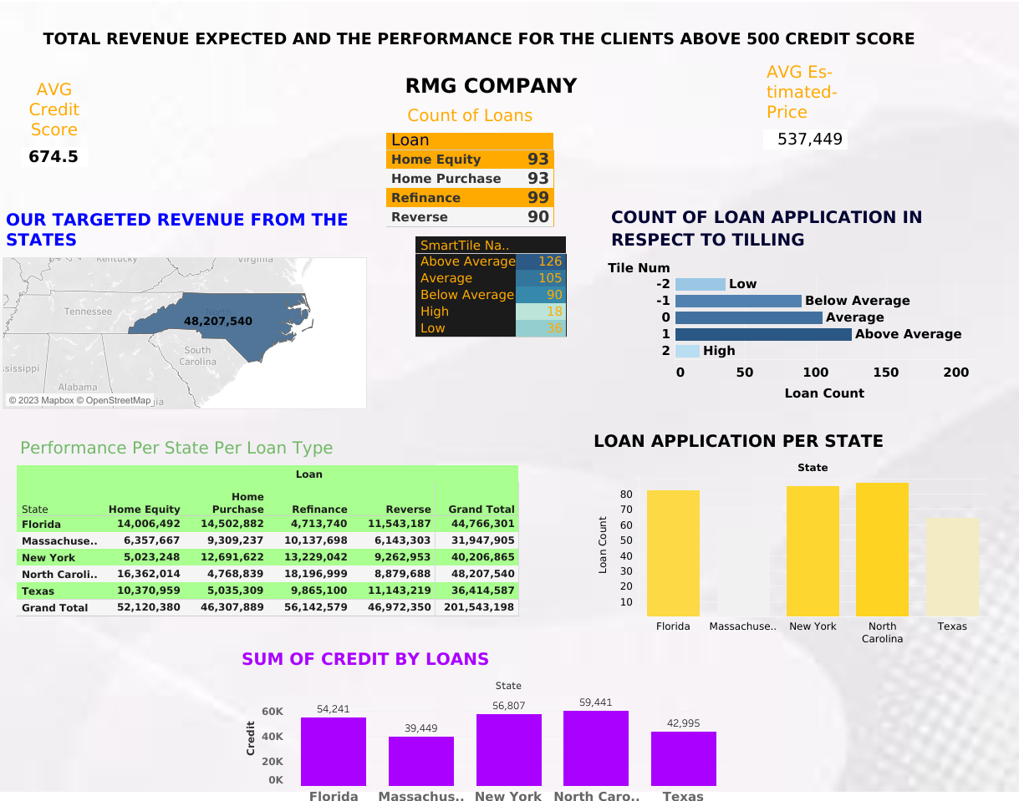

Slide 23
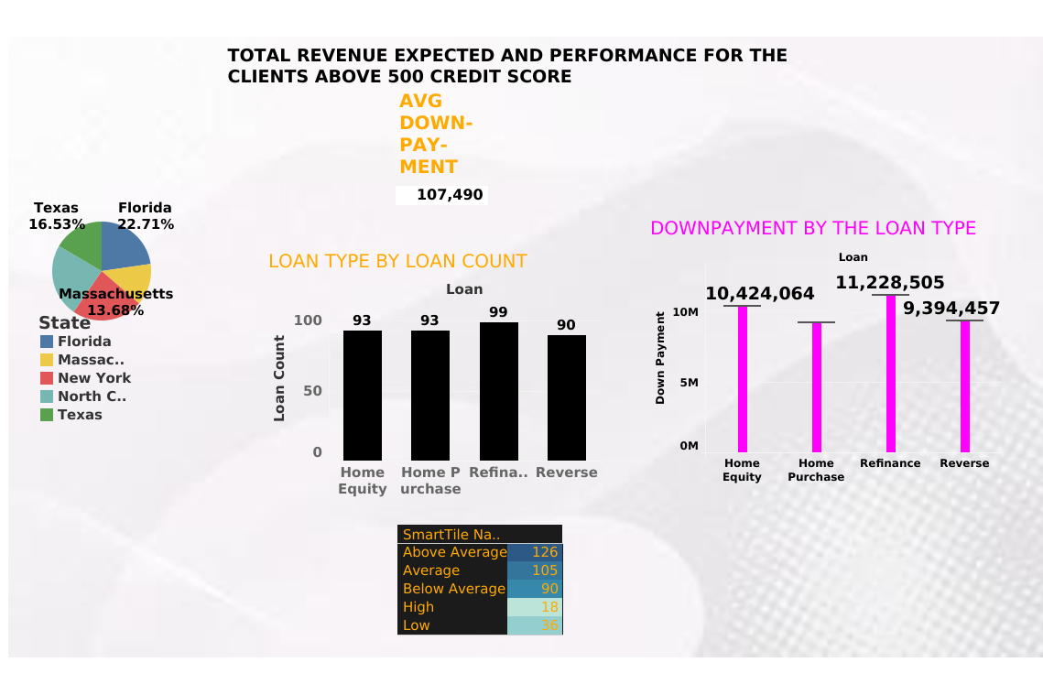

Slide 24
RECOMMENDATIONS
1.North Carolina is our main market therefore more focus in terms of marketing strategies and service delivery to maintain monopoly . The city is closely followed by Florida .The 2 states are both expected to net each above 44million in revenue anticipated,
2.From the tilling approach used in grouping ,most of our customers credit scores are average in terms of the 500 minimum score for the credit score. Those with the low performance to be re examined before being awarded the loans. Therefore a proposition to use other parameters to issue the loans.
3.From our analysis the applicants with the average , above average and high should be highly considered and loans to be awarded without much re-examination, their credit scores speaks for themselves.
4.We’re receiving applications from outside the USA, therefore a recommendation to open our operations to the countries.

Slide 25
4.From the chart the most common loans are Refinance and Home Equity therefore a proposition of more offers and re examination of the current interest rates to favor the loan applicants.
5.North Carolina has the most loan applicants above the 500 credit score mark indicating a good business performance in the location. Massachusetts has the least number with above 500.Proposition to access the market and create a wide range of short term and cheaper loans to the residents.
6.Sum of credit score from North Carolina is the highest followed by New York then Florida onto Texas then finally Massachusetts .From the above information we’re able to gauge our profit maximizing areas and the least profit maximizing areas. Proposition to improve sales in our least profit maximizing areas.
7.From the analysis report. Refinance loan type has the highest number of applicants making it the most sought for loan type .

Slide 26
8.In terms of summation of the monthly incomes, North Carolina has the highest summation, not only does it lead in numbers of loan applicants but also in summation of total monthly incomes. North Carolina is our main market with the most numbers above 500 credit score. More marketing strategies to be put in place to ensure we get more clients from North Carolina.
9.The loan issuance process needs to use this parameter in order to actualize on loan issuance
=(monthly Instalment/monthly Income)*100
The lower the value the more certain we’ll be sure the loan shall be paid with minimal difficulty.

